Slide 1
Corinthian College Closures: Next Steps for Students
May 4, 2015
1:00 PM to 2:00 PM
This live webcast is being recorded and is available at www.csac.ca.gov in the future.

Slide 2
California Student Aid Commission
CAL GRANT INFORMATION
Presented by Catalina Mistler
STUDENT SUPPORT LINE: (888) 224-7268
EMAIL: student support@csac.ca.gov
WebGrants for Students: my grant info.csac.ca.gov

Slide 3
CORINTHIAN TOOL
Visit:
oag.ca.gov/Corinthian

Slide 4
Welcome Page

Slide 5
Answer Questions

Slide 6
Tell Us About Yourself

Slide 7
Learn About Potential Relief

Slide 8
Apply for Relief

Slide 9
Explore Educational Opportunities

Slide 10
Receive Career Advice

Slide 11
CORINTHIAN TOOL
Visit:
oag.ca.gov/Corinthian

Slide 12
United States Department of Education

Slide 13
Bureau for Private Postsecondary Education
STUDENT TUITION RECOVERY FUND
Presented by Leeza Rifredi
Phone: (888) 370-7589
www.bppe.ca.gov
Notes:
Presentation purpose: Inform attendees of who we are and how to research private colleges

Slide 14
Sharon Djemal Supervising Attorney East Bay Community Law Center

Slide 15
Legal Aid Organizations can help you.

Slide 16
CORINTHIAN TOOL
Visit:
oag.ca.gov/corinthian

Slide 17
Apply for Relief

Slide 18
CORINTHIAN TOOL
Visit
oag.ca.gov/corinthian

Slide 19
California Community Colleges: Our Community
Largest System of Higher Education in the Nation
112 Colleges in California
Serving 2.1 Million Students
Awarded 190,314 certificates and degrees in 2013-14
70% of California’s Higher Education Students are Enrolled in a California Community College
20% of U.S. Community College Students are Enrolled in a California Community College

Slide 20
Our Mission
We Provide Students with Skills Needed to Compete in Today’s Job Market
Our Colleges Offer Workforce Training and Basic Skills Courses, Certificate and Degree Programs, and Preparation to Transfer to Four-Year Universities
Our System is the Nation’s Largest Workforce Training Provider

Slide 21
Fueling the Workforce
Our Colleges Offer Associate Degrees and Short-term Job Training in More Than 175 Fields
100,000 Individuals are Trained Annually in Industry-specific Workforce Skills
Twenty-nine Percent of UC and 51 Percent of CSU Graduates Started at a California Community College
Nearly 42 percent of California Veterans Receiving GI Educational Benefits Attend a California Community College for Workforce Training or a Degree

Slide 22
Fueling California’s Workforce
Our graduates and certificate earners:
Keep you safe ~
80% of firefighters, EMTs and police officers are trained at our colleges
Keep you healthy ~
70% of California nurses are educated at community colleges
Innovate ~
48% of UC bachelor’s degree holders in STEM majors transferred from a community college

Slide 23
High Return on Investment
Californians with a college degree will earn $1.3 million more than those with a high school diploma.
Californians with an associate degree or certificate nearly double their earnings in three years.
Graduating from a community college doubles an individual’s chance of finding a job compared to those who failed to complete high school.

Slide 24
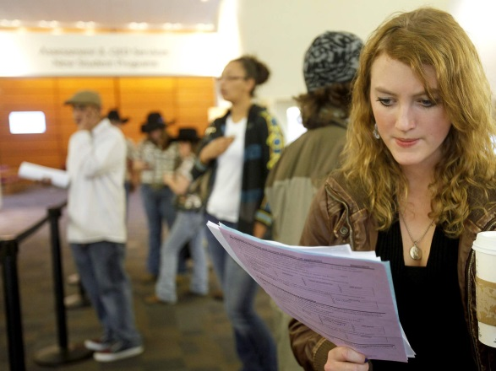
Financial Aid is Smart Money
The most affordable public higher education in the nation at $46 per unit
More than 1 million students, 45 percent of our student body, received a BOG Fee Waiver in 2013-14
More than $2.7 billion in financial aid is awarded annually
Visit ICanAffordCollege.com website for info on financial aid

Slide 25
Connect With Us!
Connect with all 112 local community colleges: communitycolleges.cccco.edu
Enroll in your local community college: CCCApply.org
See your potential earnings after completing a certificate or degree: salarysurfer.cccco.edu
Find out information about guaranteed transfer to CSU: adegreewithaguarantee.com

