Slide 2
Status of Financial Aid for
California Higher Education Undocumented Students

Slide 3
Webinar Tips
This webinar is being recorded so that others may view and listen to it at a later time. This and other CSAC webinars can be found at www.csac.ca.gov under “News & Events”.
All participant mics have been muted and video access has been disabled for the duration of this webinar.
Since all participants are muted, please use the Q&A Box to enter your questions
Participants can submit a question in the Q&A Box located at the bottom of your screen
Only panelists and facilitators will be able to answer the questions publicly or privately to the individual
**Every effort has been made to ensure the security of this webinar from “Zoombombers”, but in the event that we experience that, please stay calm and we will resume with the webinar as soon as the technical difficulties have been resolved.**

Slide 4
Agenda Overview
1
Welcome
2
Data & Policy Considerations
3
Panel
4
Q&A

Slide 5
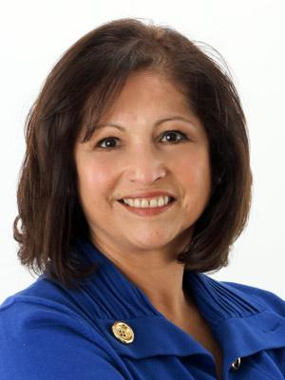
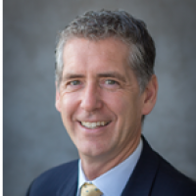
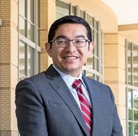
Marlene Garcia Executive Director, CSAC
Charles Nies Commissioner, CSAC
Vice Chancellor for Student Affairs, UC Merced
Eric Guerra Council Member, District 6
City of Sacramento

Slide 6
Status of Financial Aid for
California Higher Education Undocumented Students
Teresita Martinez, Executive Fellow
California Student Aid Commission

Slide 7
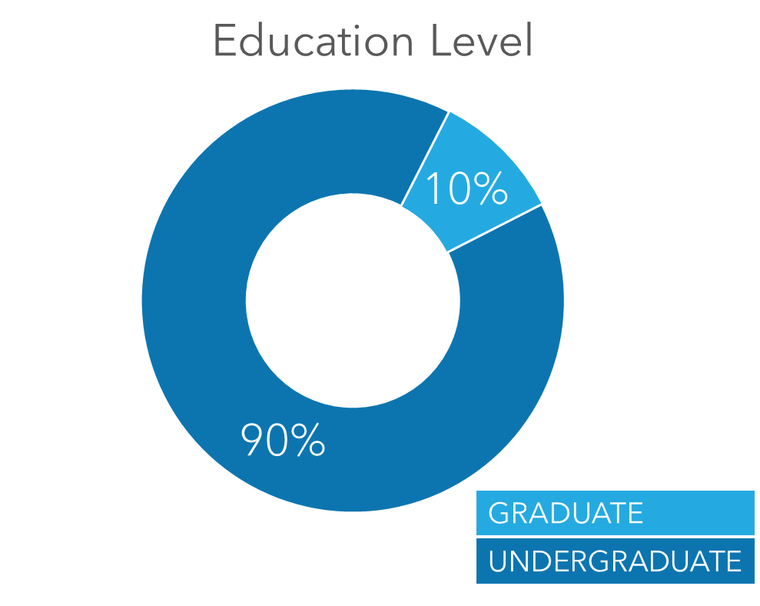
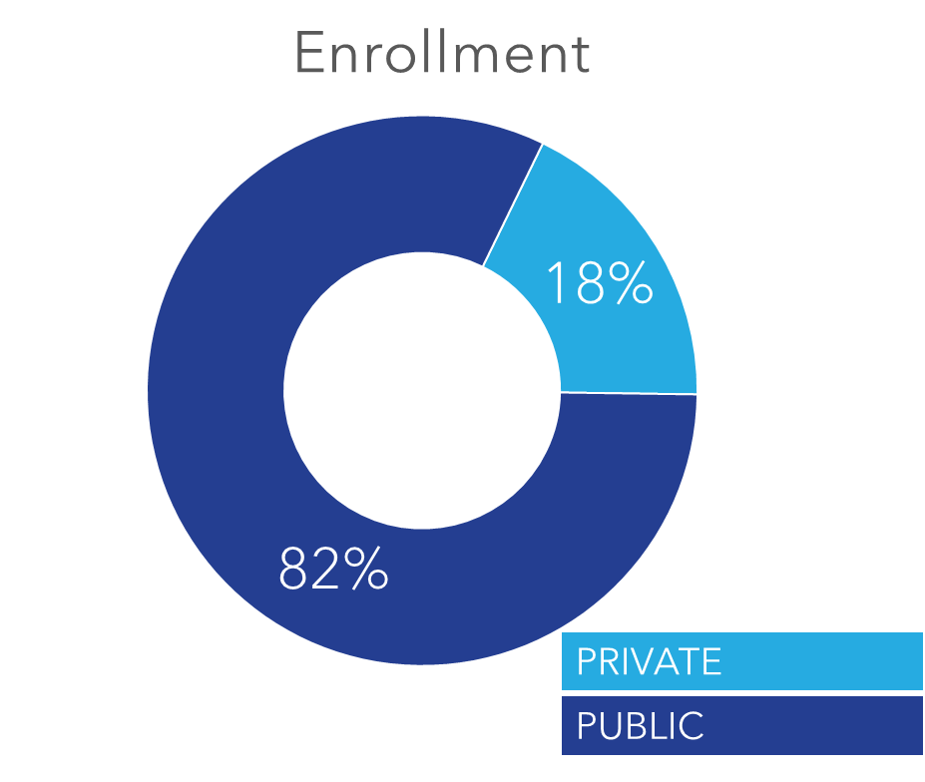
Notes:
Throughout the U.S., majority of undocumented students in higher education are undergraduates and attend some type of public institution
I’d like to note that there are undocumented students who are pursuing their graduate studies and there students that attend some type of private institution.

Slide 8
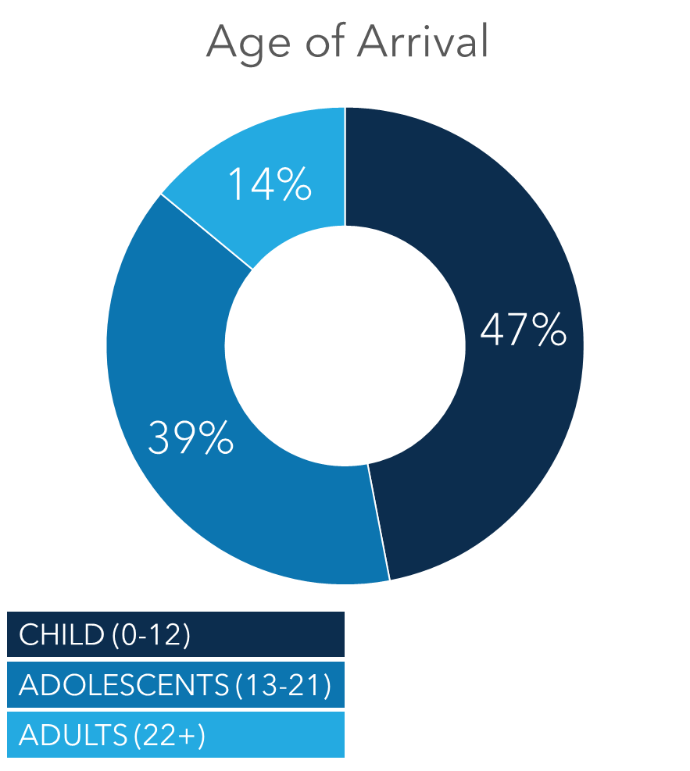
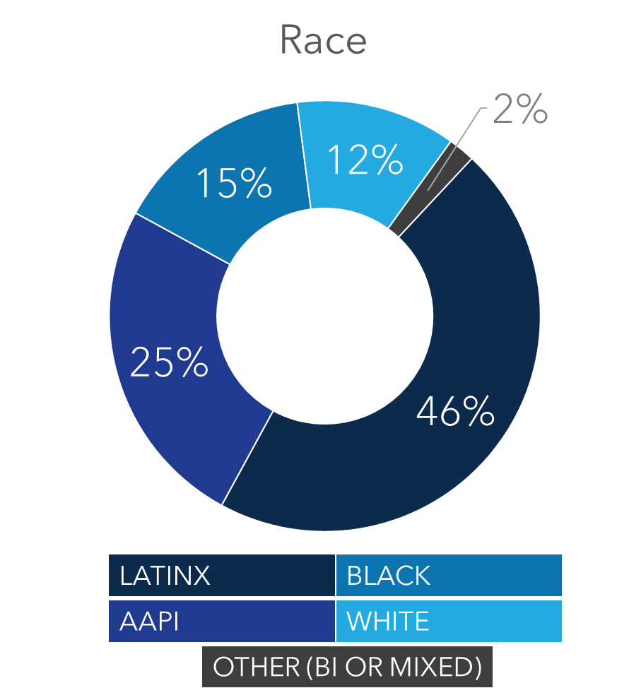
Notes:
Additionally, the majority of students came to the united states as children or adolescents and therefore matriculated into the US education system
14% of the student population came as adults which introduces a new population that hasn’t been considered by policy, which is the undocumented. adult. Learners.
The undocumented student population is very diverse with the majority being Latinx and AAPI

Slide 9
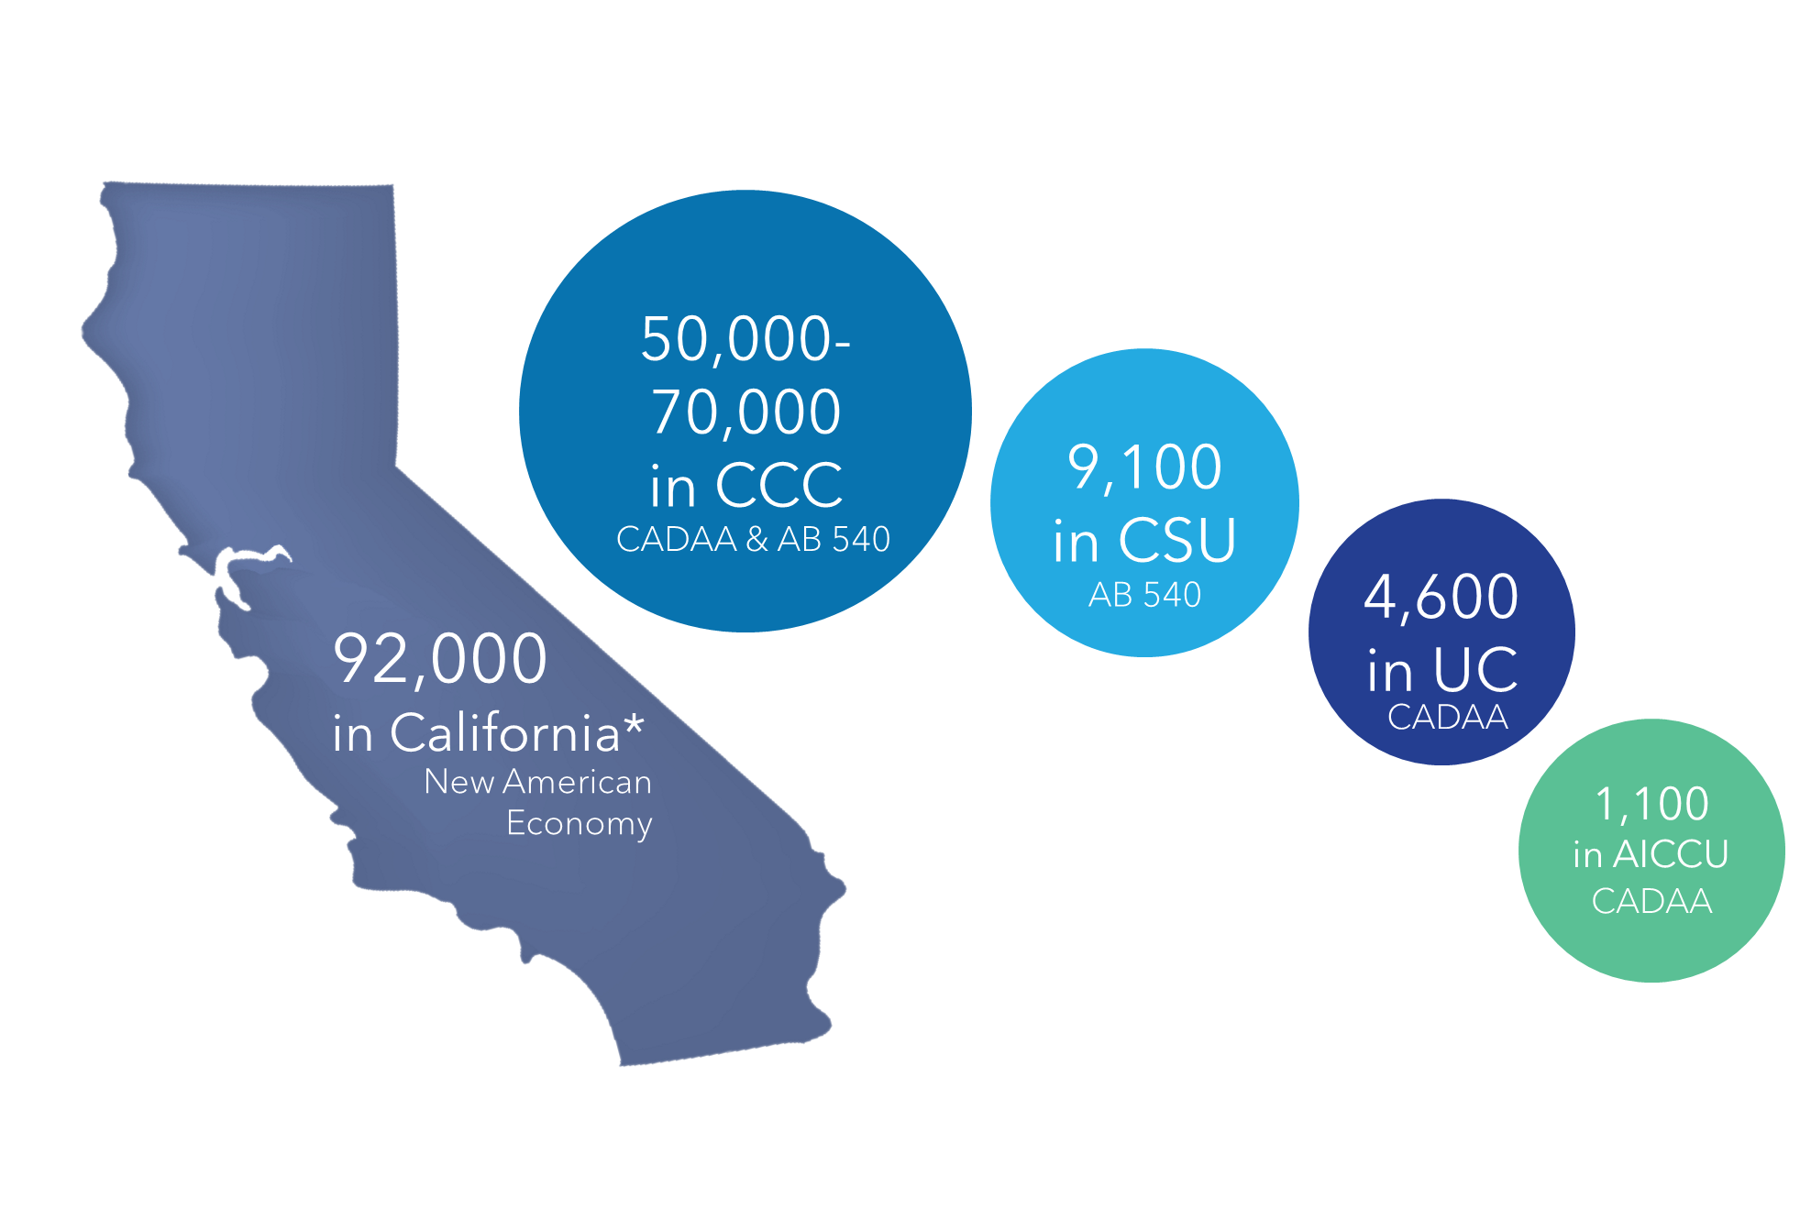
Slide 5
Notes:
In California,
There are roughly 92,000 undocumented students in higher education
The majority are in CCC and CSU
There are roughly 5K undocumented students attending UC institutions and about 1K attending private-non profit universities

Slide 10
California Dream Act Application (CADAA or CA Dream Act)
California financial aid application created for undocumented students ran by CSAC. Created in 2011, enacted in 2013-14.
Deferred Action for
Childhood Arrivals
(DACA)
U.S. immigration policy that provides eligible immigrants protection from deportation and a work permit
Assembly Bill 540, Assembly Bill 200 & Senate Bill 68
(AB 540)
California legislation that allows students (including undocumented students) to qualify for in-state tuition
Notes:
Before we move forward, I’d like to define a couple of important terms that I will be referencing a lot throughout this presentation
California Dream Act Application AKA CADAA or the California Dream Act: financial aid application for undocumented students or students who are not eligible to fill out the FAFSA created by California and ran by the CSAC
Deferred Action for Childhood Arrivals AKA DACA: immigration policy that provides eligible undocumented individuals protection from deportation and a work permit
AB 540: residency requirement for students to receive in-state tuition in California

Slide 11
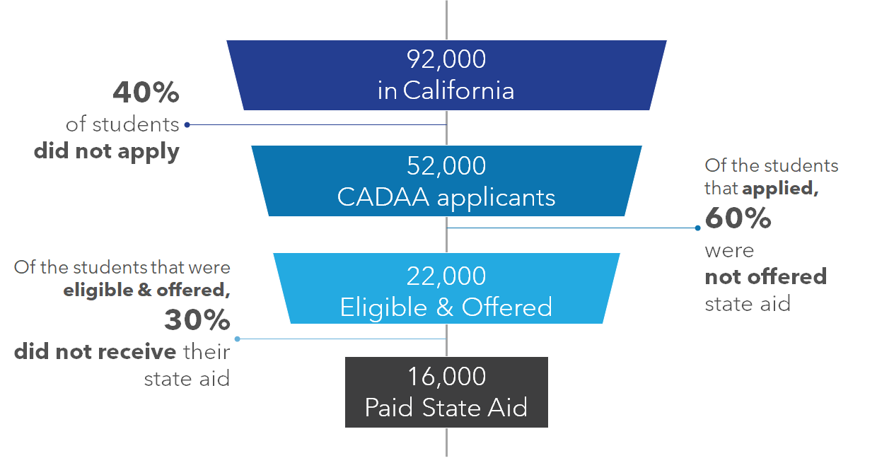
Notes:
Of the estimated number of California undocumented students,
40% did not apply to the California Dream Act Application and therefore did not apply to receive financial aid
Of those that applied, 60% were not offered a state financial aid award like the Cal Grant, Middle Class Scholarship, or Chafee
Of those that were eligible & offered, 30% did not receive their state aid

Slide 12
AB 540 & CADAA are Gateways
Notes:
If a student is AB 540, they are eligible to pay in-state tuition. If they also fill out the CADAA, they are now able to be considered for state financial aid.

Slide 13
AB 540 & CADAA are Gateways
Notes:
Not only does AB 540 & CADAA open opportunities to be considered for state financial aid and pay in-state tuition, it also opens opportunities to be considered for institutional financial aid. At CCC, students can still receive some type of aid by being AB 540-eligible, but by them not filling out the CADAA they lose out on the opportunity to receive state financial aid. On contrary, at four-year public universities, students must fill out the CADAA and be AB 540-eligible to be considered for institutional financial aid
AB 540 & CADAA are the gateways to receive state and institutional financial aid. So, that 40% of undocumented student that did not apply to the CADAA lost out on the opportunity to be considered for these awards

Slide 14
Institutions providing financial aid support
Notes:
CADAA allows students at four-year universities to receive institutional financial aid
About 5K UCs and 7K CSUs
This number is unknown for private non-profit universities
Through DACA, about 1K students at UCs are eligible to have on-campus work. However, after Trump rescinded DACA (2017), there were no new DACA applicants.
Even more urgency to capture students that are falling through the state financial aid cracks
UCOP
*Institutional work-study and on-campus work is only available to students with Deferred Action for Childhood Arrivals (DACA) status

Slide 15
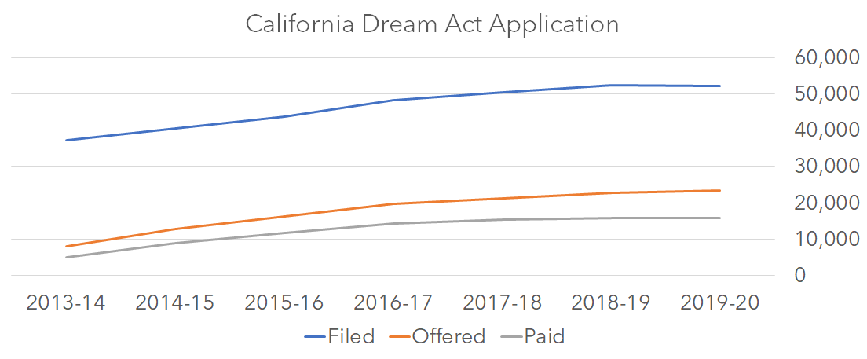
Notes:
The gap between the overall students that applied, were offered, and received state financial aid has been persistent since the application’s initiation in 2013-14.

Slide 16
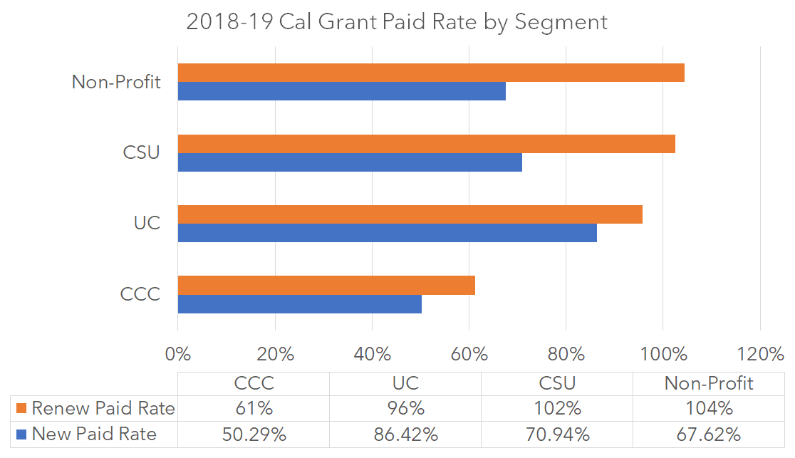
Notes:
However, this gap is more prominent for a specific group within the undocumented students that are applying.
By looking at the paid rate and grouping them by students that are reapplying and applying for the first-time, we see that there is a disparity between these two student groups.
The paid rate is the ratio of those that received an award to those that were offered. Essentially the paid rate is measuring how successful eligible & offered students are at receiving their awards.
New students are those that apply to the CADAA for the first time and renewal students are those that are continuing to apply.
New student applicants need to take additional steps to receive state financial aid such as filling out the AB 540 affidavit and if they are male, enlisting in the selective service (2-3 month process). Renewal students don’t have these additional steps and have a higher chance of understanding the application process than new students.

Slide 17
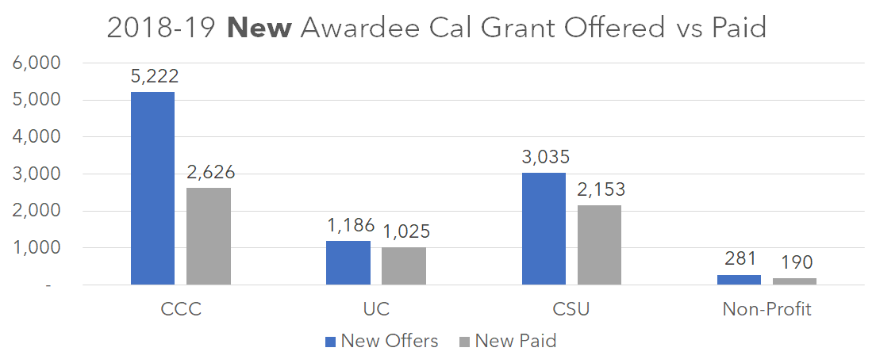
Notes:
When we look at the new applicant pool by higher education segment, the majority of students that are being offered a Cal Grant attend a community college but the paid rate is about 50%. The paid rate is an issue throughout all segments, but it is substantially lower at community colleges
When we consider that the majority of undocumented students are attending community colleges, this very concerning

Slide 18
Notes:
Problem hasn’t gotten any better
First-time applicants, there is a steady decrease on the number of students applying to CADAA with a total decrease of about 25% since 2013-14
The amount of offers for new applicants had a small increased about 35%
There was a positive change in students getting paid out their awards, however since 2016-17 there was a steady decline. Overall, there was an increase of about 15% for student getting paid their award.
Both offered and paid numbers displayed similar behaviors initially, but after 2016-17 the rate of awards getting paid out to students slows down substantially.
First time applicants are facing challenges to apply, be offered, and ultimately paid out an award

Slide 19
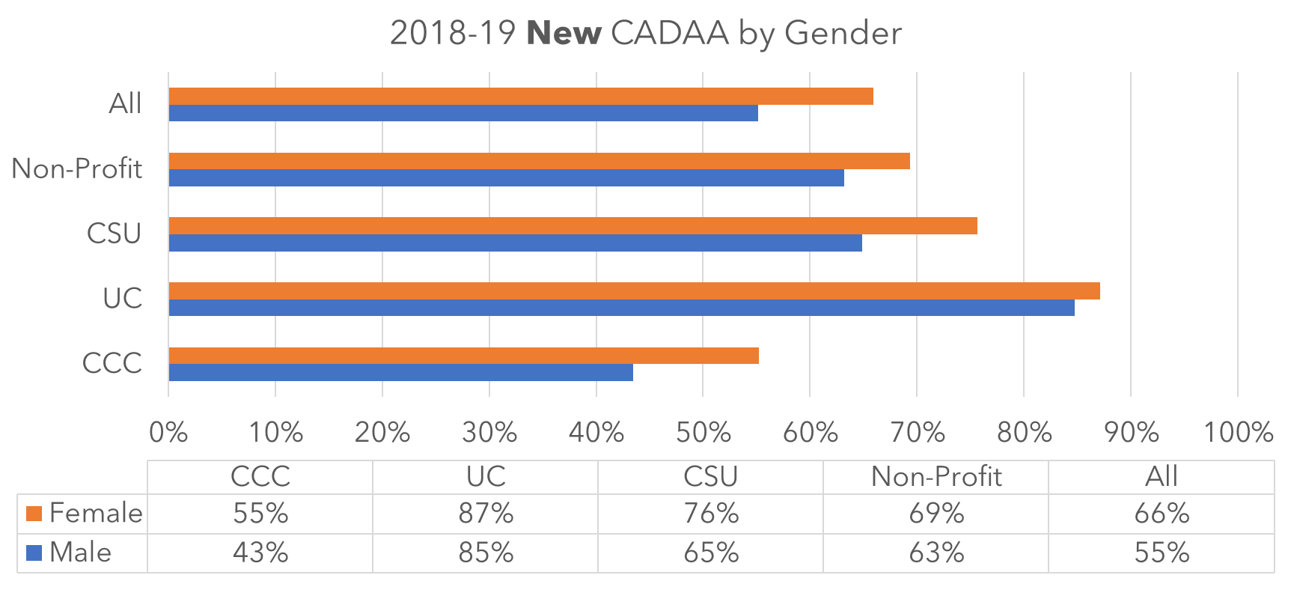
Notes:
If we look at the gender gaps for first time applicants, we see that throughout segments, male students have a lower paid rate than females
Male first-time applicants have to go through an additional step to receive state financial and that is to enroll in the selective service. Which may take 2-3 months to process.

Slide 20
HS/College Counselor
Financial aid application assistance
Source of
income/assets/investment information
Technology access
(i.e. library/school)
California Dream Act Application
WebGrants
College/University Records office
Chafee application
Source of income verification
Selective Service
20% randomly selected for verification
Financial Aid Office
Source of AB 540 verification
Source of CA residency verification
Notes:
A new applicant could have visited 10 different individuals, offices, and platforms in the process of filling out and receiving state financial aid
Higher chance of misinformation, miscommunication, and misguidance and therefore a higher chance of students having mistrust, fear, and anxiety throughout the process
When CSAC randomly select 20% of California Dream Act Applicants for verification, we add even more steps for those students. Exacerbating the issues that I mentioned earlier of misinformation, miscommunication, and misguidance. Which can cause even more fear and anxiety, and therefore can discourage them to continue the process of applying for aid and potentially never coming back.

Slide 21
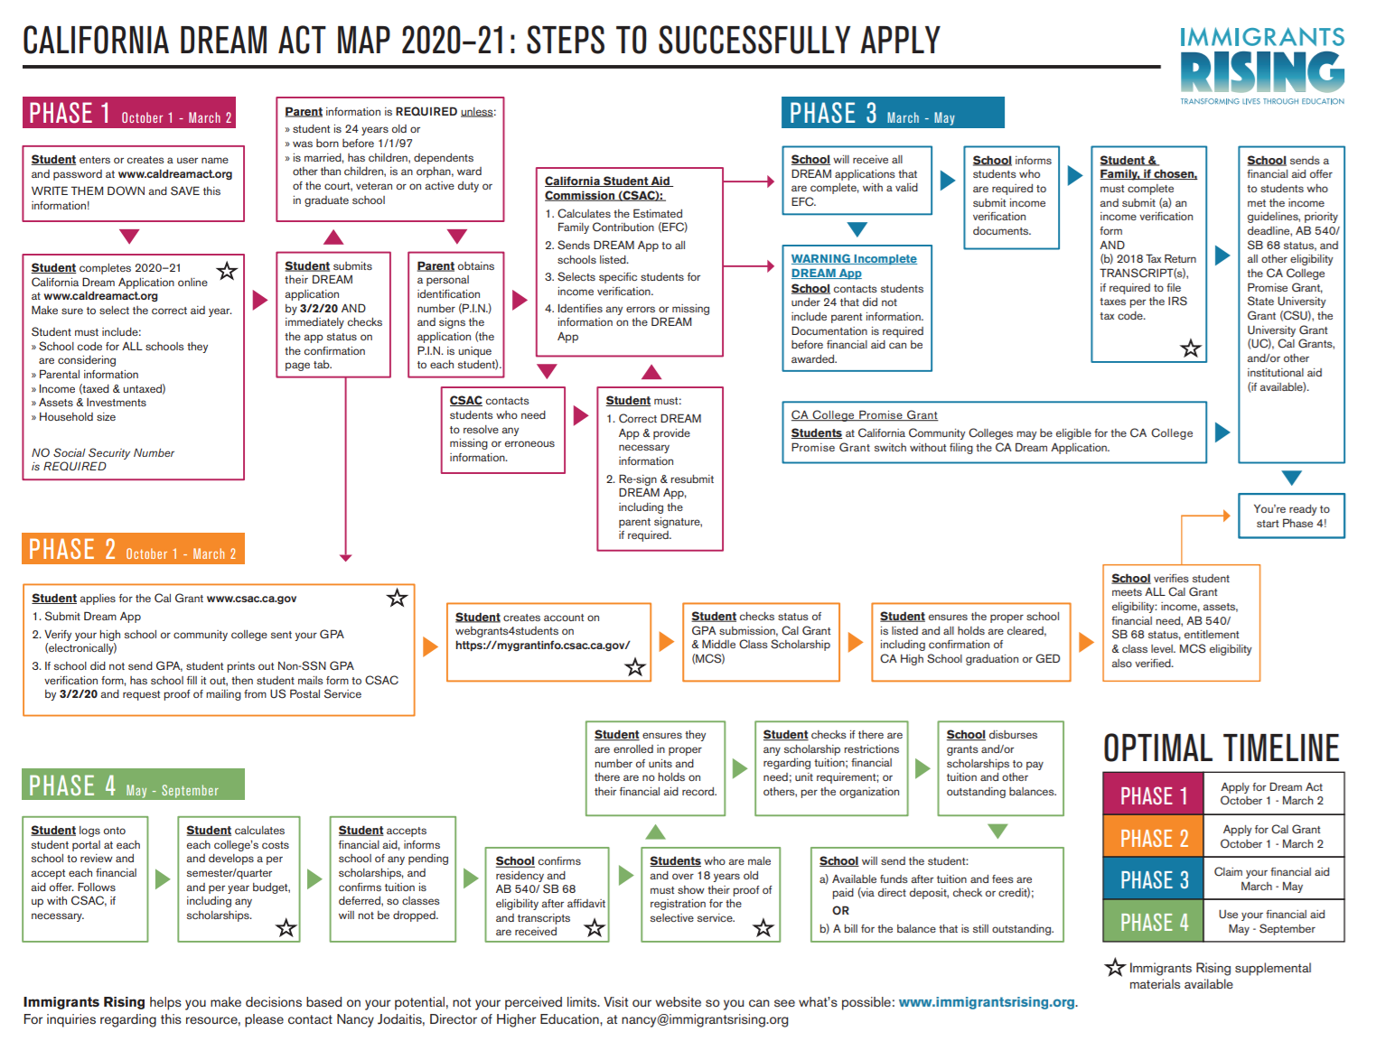
Notes:
If we consider the user experience for successfully applying to receive state financial aid as a new applicant. It is overwhelming and confusing. It took me about 5 sessions with the CSAC training and outreach team to understand the application process.
I’d like to remind you that THESE ARE UNDOCUMENTED STUDENTS. MAJORITY ARE FIRST GENERATION and therefore may be going through this process alone. Unreasonable to expect them to go through this complicated financial aid process that was not built to consider their unique challenges as undocumented students.

Slide 22
Policy Considerations
Address undocumented student eligibility/access barriers in the Cal Grant Modernization proposal
Bring together a CADAA workgroup to assess and improve the CADAA
Simplified process
Verification
AB 540 affidavit integration
Leveraging data sources that can inform policy and outreach
Partnerships with financial aid offices and external stakeholders to promote outreach and awareness of financial aid opportunities
Information campaign to combat misinformation, fear, and unawareness for students and families
Identify other financial resources to make up for FAFSA ineligibility
Notes:
Combat disparities that we saw with new applicants and new male applicants.
CGM
Consider the challenges that are common to undocumented students when applying and receiving the Cal Grant in the Cal Grant Modernization Proposal
Consider the undocumented student adult population, which make up about 14% of total undocumented students in higher ed
CSAC has the unique power to create meaningful structural change in the California Dream Act Application
Potential to deviate from the FAFSA structure and create a groundbreaking financial aid application that caters to the unique needs of California undocumented students.
CSAC has the potential to eliminate the structural barriers that are the common reasons for students falling through the cracks (such as the verification, ab 540 affidavit, and selective service requirement)
We can bring together external and internal CADAA experts to streamline and strengthen the application process
Consider having a strong data source that can allows us to clearly identify why students aren’t offered and receiving their state financial aid
Consider that CADAA is not only used to apply to Cal Grant, but also to apply to other types of aid. Ultimately, CADAA is the gateway to financial aid
Partnership
During this pandemic, it is essential that we need to partner with financial aid office and external stakeholders involved in all aspects of the CADAA process to promote outreach and awareness
Ensure that stakeholders are mindful of the barriers that undocumented student face and work together to ensure that students don’t fall through the cracks. Especially new applicants and new male applicants.
Information campaign is essential because of the pandemic to ensure that students are at least aware that there are financial aid opportunities for them. Empower students and families to apply.
Because undocumented students are not eligible for federal financial aid and because of instability of DACA, students have a limited amount of financial aid opportunities.
Collaborate with higher education segments and policy advocates to understand the unmet need and identify financial aid resources to make up for that gap

Slide 23
The Northern California
Undocu-Center Collaborative
Thank you
Notes:
Advocacy partners: Immigrants Rising, Campaign for College Opportunity, TICAS, Northern California Undocu-Centers Collaborative, and CHIRLA
Higher education segment partners: UC, CSU, CCC, AICCU
CSAC teams: Government Relations, Policy, research and data, Program Administration & services team

Slide 24
Questions?

Slide 25
Panel
Jake Brymner (Moderator)
Director of Government & External Relations, CSAC
Nancy Jodaitis
Director of Higher Education, Immigrants Rising
Erik Ramirez
Program Coordinator, Dreamer Resource Center, Sacramento State University
Fatima Hernandez
Student, San Joaquin Delta College
Michelle Segura Padilla
Graduate student, CSU Los Angeles
Attended LA Trade-Tech College & transferred to CSU Long Beach

Slide 26
Resources to Support Undocumented Students immigrantsrising.org

Slide 27
Questions?

Slide 28
Slide 6
Engage with us on Social Media
@CAStudentAid
@CAStudentAid
https://www.facebook.com/calstudentaid
https://www.linkedin.com/in/california-student-aid-commission-69978764
https://www.youtube.com/user/CaStudentAid

Slide 29
Slide 7
Websites:
csac.ca.gov
dream.csac.ca.gov
mygrantinfo.csac.ca.gov
Office Phone: 1-888-224-7268
Email: StudentSupport@csac.ca.gov (Students)
SchoolSupport@csac.ca.gov (Admin)

