Slide 1
Senate Budget and Fiscal Review Subcommittee #1 on Higher Education
Thursday, April 25, 2013

Slide 5
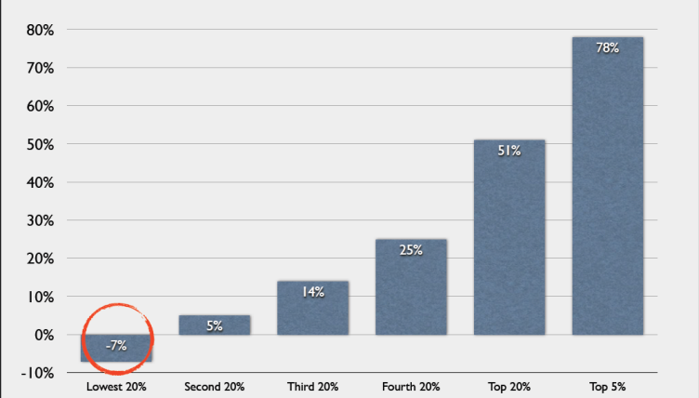
National Data

Slide 6
FEDERAL CUTS DUE TO SEQUESTRATION
9.8 percent cut in Federal Work Study funding for California college and university students.
8.7 percent cut in Federal Supplemental Educational Opportunity Grants for California college and university students.
Source: U.S. Senate Appropriations Committee Majority Staff
Pell Grant awards, are slated for funding reductions after the first year of the sequester affecting more than 1 million California college and university students

